Slide 1

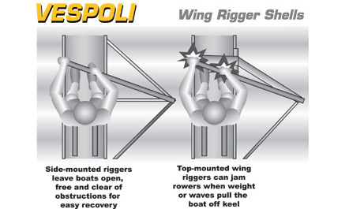
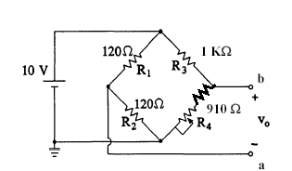
Oar Pressure
Our goal is to measure the pressure being applied to each oar by the rower. To do this, we are going to incorporate
two strain gauges to each oar in a Wheatstone Bridge configuration. The strain gauges will be placed half way between
the rigger connection housing and the hatchet connection as this is where most of the bend in the oar occurs. Since
all oars are precisely manufactured to bend equally, we can measure pressure applied by the rower using this pressure
to bending in the oar relationship.
Strain Gauge Placement
Front and Rear
Wheatstone Bridge Diagram
Force Application
The Wheatstone Bridge will
give us the proper directional
and proportional output given
the strain gauge resistive input.
ENCL-4.1

